Slide 1



01AI0506 - Design and Analysis of Algorithms
Unit – 3
Dynamic Programming
Prepared by
Prof. Abhishek Chauhan
CSE- AI, ML & DS Department

Slide 2


OUTLINE
    Introduction
    Elements of Dynamic Programming
    Problem Solving using Dynamic Programming
        Making Change Problem
        Assembly Line-Scheduling
        Matrix chain multiplication
        Longest Common Subsequence

Slide 3
Introduction
Dynamic programming is used to solve the optimization problems.
Dynamic programming, like the divide-and-conquer method, solves problems by combining the solutions to sub problems. But we will never solve the same subproblem twice.
Divide-and-conquer algorithms partition the problem into independent sub problems, solve the sub problems recursively, and then combine their solutions to solve the original problem.

Slide 4
Introduction
In this context, a divide-and-conquer algorithm does more work than necessary, repeatedly solving the common sub problems.
Dynamic Programming is an algorithmic paradigm that solves a given complex problem by breaking it into subproblems and stores the results of subproblems to avoid computing the same results again.

Slide 5
Steps of Dynamic Programming Approach
Dynamic Programming algorithm is designed using the following steps,
Breaks down the complex problem into simpler subproblems
Find optimal solution to those subproblems
Store the results of subproblems
Reuse the results .so that same subproblem is not calculated more than once.
Finally calculates the results of complex problem.

Slide 6
Elements of Dynamic Programming
There are basically three elements that characterize a dynamic programming algorithm
Substructure
Table Structure
Bottom-up Computation

Slide 7
Elements of Dynamic Programming
Substructure: Decompose the given problem into smaller sub problems. Express the solution of the original problem in terms of the solution for smaller problems.
Table Structure: After solving the sub-problems, store the results to the sub problems in a table. This is done because sub problem solutions are reused many times, and we do not want to repeatedly solve the same problem over and over again.
Bottom-up Computation: Using table, combine the solution of smaller sub problems to solve larger sub problems and eventually arrives at a solution to complete problem.

Slide 8

Principle of optimality
A problem is said to satisfy the Principle of Optimality if the sub-solutions of an optimal solution of the problem are themselves optimal solutions for their subproblems.
Dynamic programming is a technique for finding an optimal solution.
The principle of optimality applies if the optimal solution to a problem always contains optimal solutions to all subproblems.

Slide 9
Divide & Conquer Vs. Dynamic Programming
Divide and Conquer | Dynamic Programming
1) Divide-and-conquer is a top- down method | 1) Dynamic Programming is a bottom- up technique.(We usually start with the smallest, and hence the simplest, sub instances. )
2) In Divide and Conquer the sub problems are independent of each other. | 2) In Dynamic Programming the sub problems are not independent.
3) Divide and Conquer does more work on the sub problems. | 3) Dynamic Programming solves the sub problem only once and then stores it in table.
4) Has more time consumption | 4) Has less time consumption

Slide 10
Applications of Dynamic Programming
        Making Change Problem
        Knapsack problem
        Assembly Line-Scheduling
        Matrix chain multiplication
        Longest Common Subsequence
        Calculating the Binomial Coefficient
        Travelling Salesman Problem

Slide 11
Making a Change Problem
How to Solve Making Change using Dynamic Programming?
Making Change problem is to find change for a given amount using a minimum number of coins from a set of denominations.
Explanation :
If we are given a set of denominations D = {d₀, d₁, d₂, …, d_{n}} and if we want to change for some amount N, many combinations are possible. Suppose {d₁, d₂, d₅, d₈}, {d₀, d₂, d₄}, {d₀, d₅, d₇} all feasible solutions.
The aim of making a change is to find a solution with a minimum number of coins / denominations. Clearly, this is an optimization problem.

Slide 12
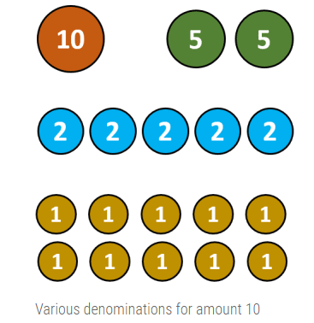
Making a Change Problem
Way of making a change for Rs.10

Slide 13
Making a Change Problem
If current denomination is larger than current problem size, then we have to skip the denomination and stick with previously calculated solution. Hence,
C[i, j] = C[i – 1, j]
Our objective is to find minimum number of coins, so at each step, we have to stick with choice which returns minimum number of coin. Mathematically, we formulate the problem as,
C[i, j] = min {C[i – 1, j] , 1 + C[i, j – di]}

Slide 14
Making a Change Problem
Algorithm :

Slide 15
Making a Change Problem
Where,
    di = i^{th} denomination ,1 ≤ i ≤ n
    j = Size of sub problem
    C[1…..n, 0…..N] = Size of the problem
    C[n, N] = Solution of the problem
    n = Number of denomination
    N = Amount for which change is required By combining all three cases, we have
1. if i=1 then C[i,j] = 1 + C[1, j-d1]
2. if j<di then C[i,j] = C[i-1, j]
3. Otherwise c[i,j] = min{c[i-1,j], 1+c[i,j-di]}
Note: If no combination of coins sums to amount j, then C[i, j] = ∞

Slide 16
Making a Change Problem
Example:
Consider an instance of a problem with coins 1, 4 and 6 units. Illustrate its solutions using dynamic programming approach involving a payment of 8 units.
Mathematical Formulation
Sort all the denomination and start scanning from largest to smallest denomination. In every iteration i, if current denomination di is acceptable, then 1 coin is added in solution and total amount is reduced by amount di. Hence, C[i, j] = 1 + (c [1, j – d1])

Slide 17
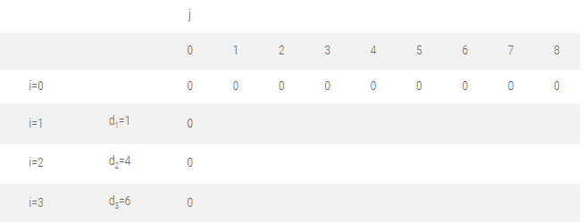
Making a Change Problem
Let us find the optimal solution for D = {d₁, d₂, d₃} = {1, 4, 6} and N = 8.
Initialize the table C [i, 0] = 0 and C [0, j] = 0.
These indicate we don’t have any denomination and size of problem is zero respectively.
You can fill up the values in the table either way – by row wise or column wise.

Slide 18
Making a Change Problem
Note: We may fill the values either row wise or column wise
Filling first column, j = 1 :
C [1, 1] ⇒ i = 1, j = 1, d_{i} = d₁ = 1
As, i = 1, formula 1 is used
C [i, j] = C [1, 1] = 1 + C [1, j – d₁ ]
= 1 + C [1, 1 – 1]
= 1 + C [1, 0]
= 1
C [2, 1] ⇒ i = 2, j = 1, d_{i} = d₂ = 4
As, j < d₂, i.e. 1< 4
C [i, j] = C [2, 1] = C [i – 1, j] = C [1, 1] = 1
C [3, 1] ⇒ i = 3, j = 1, d_{i} = d₃ = 6
As, j < d₃,
C [3, 1] = C [i – 1, j]
= C[3-1,1]
= C [2, 1]
= 1
if i=1 then C[i,j] = 1 + C[1, j-d1]
if j<di then C[i,j] = C[i-1, j]
Otherwise c[i,j] = min{c[i-1,j], 1+c[i,j-di]}

Slide 19
Making a Change Problem
Filling second column, j = 2 :
C [1, 2] ⇒ i = 1, j = 2, d_{i} = d₁ = 1
As, i = 1, formula 1 is used
C [i, j] = C [1, 2] = 1 + C [1, j – d₁]
= 1 + C [1, 2 – 1]
= 1 + C [1, 1]
= 1 + 1
= 2
C [2, 2] ⇒ i = 2, j = 2, d_{i} = d₂ = 4
As, j < d₂,
C [i, j] = C [2, 2] = C [i – 1, j]
= C [1, 2]
= 2
C [3, 2] ⇒ i = 3, j = 2, d_{i} = d₃ = 6
As, j < d₃,
C [i, j] = C [3, 2] = C [i – 1, j]
= C [2, 2]
= 2
if i=1 then C[i,j] = 1 + C[1, j-d1]
if j<di then C[i,j] = C[i-1, j]
Otherwise c[i,j] = min{c[i-1,j], 1+c[i,j-di]}

Slide 20
Making a Change Problem
Filling third column, j = 3 :
C [1, 3] ⇒ i = 1, j = 3, d_{i} = d₁ = 1
As, i = 1, formula 1 is used
C [i, j] = 1 + C [1, j – d₁ ]
= 1 + C [1, 3 – 1]
= 1 + C [1, 2]
= 1 + 2
= 3
C [2, 3] ⇒ i = 2, j = 3, d_{i} = d₂ = 4
As, j < d_{i},
C [i, j] = C [2, 3] = C [i – 1, j]
= C [1, 3]
= 3
C [3, 3] ⇒ i = 3, j = 3, d_{i} = d₃ = 6
As, j < d_{i},
C [i, j] = C[3,3] = C [i – 1, j]
= C [2, 3]
= 3
if i=1 then C[i,j] = 1 + C[1, j-d1]
if j<di then C[i,j] = C[i-1, j]
Otherwise c[i,j] = min{c[i-1,j], 1+c[i,j-di]}

Slide 21
Making a Change Problem
Filling fourth column, j = 4 :
C [1, 4] ⇒ i = 1, j = 4, d_{i} = d₁ = 1
As, i = 1 formula 1 is used
C [i, j] = 1 + C [1, j – d₁]
C [1, 4] = 1 + C [1, 4 – 1]
= 1 + C [1, 3]
= 1 + 3
= 4
C [2, 4] ⇒ i = 2, j = 4, d_{i} = d₂ = 4
As i ≠ 1 and j ≥ d_{i}
C [i, j] = min { C [i – 1, j], 1 + C [i, j – d_{i}] }
C [2, 4] = min { C [1, 4], 1 + C [2, 4 – 4] }
= min { C [1, 4], 1 + C [2, 0] }
= min {4, 1 + 0}
= 1
C [3, 4] ⇒ i = 3, j = 4, d_{i} = d₃ = 6
As j < d_{i},
C [i, j] = C [i – 1, j]
C [3, 4] = C [2, 4]
= 1
if i=1 then C[i,j] = 1 + C[1, j-d1]
if j<di then C[i,j] = C[i-1, j]
Otherwise c[i,j] = min{c[i-1,j], 1+c[i,j-di]}

Slide 22
Making a Change Problem
Filling fifth column, j = 5 :
C [1, 5] ⇒ i = 1, j = 5, d_{i} = d₁ = 1
As, i = 1 formula 1 is used
C [i, j] = 1 + C [1, j – d₁]
= 1 + C [1, 5 – 1]
= 1 + C [1, 4]
= 1 + 4
= 5
C [2, 5] ⇒ i = 2, j = 5, d_{i} = d₂ = 4
As i ≠ 1 and j ≥ d_{i} , So,
C [i, j] = min { C [i – 1, j], 1 + C [i, j – d_{i}] }
= min { C [1, 5], 1 + C [2, 1] }
= min {5, 1 + 1}
= 2
C [3, 5] ⇒ i = 3, j = 5, d_{i} = d₃ = 6
As j < d_{i},
C [i, j] = C [i – 1, j]
C [3, 5] = C [2, 5]
= 2
if i=1 then C[i,j] = 1 + C[1, j-d1]
if j<di then C[i,j] = C[i-1, j]
Otherwise c[i,j] = min{c[i-1,j], 1+c[i,j-di]}

Slide 23
Making a Change Problem
Filling sixth column, j = 6 :
C [1, 6] ⇒ i = 1, j = 6, d_{i} = d₁ = 1
As, i = 1formula 1 is used
C [i, j] = 1 + C [1, j – d₁]
= 1 + C [1, 5]
= 1 + 5
= 6
C [2, 6] ⇒ i = 2, j = 6, d_{i} = d₂ = 4
As i ≠ 1 and j ≥ d_{i}
C [i, j] = min { C [i – 1, j], 1 + C [i, j – d_{i}] }
= min { C [1, 6], 1 + C [2, 2] }
= min {6, 1 + 2}
= 3
C [3, 6] ⇒ i = 3, j = 6, d_{i} = d₃ = 6
As i ≠ 1 and j ≥ d_{i}
C [i, j] = min { C [i – 1, j], 1 + C [i, j – d_{i}] }
= min { C [2, 6], 1 + C [3, 0] }
= min {6, 1 + 0}
= 1
if i=1 then C[i,j] = 1 + C[1, j-d1]
if j<di then C[i,j] = C[i-1, j]
Otherwise c[i,j] = min{c[i-1,j], 1+c[i,j-di]}

Slide 24
Making a Change Problem
Filling seventh column, j = 7 :
C [1, 7] ⇒ i = 1, j = 7, d_{i} = d₁ = 1
As, i = 1 formula 1 is used
C [i, j] = 1 + C [i, j – d_{i}]
= 1 + C [1, 6]
= 1 + 6
= 7
C [2, 7] ⇒ i = 2, j = 7, d_{i} = d₂ = 4
As i ≠ 1 and j ≥ d_{i}
C [i, j] = min { C [i – 1, j], 1 + C [i, j – d_{i}] }
= min { C [1, 7], 1 + C [2, 3] }
= min {7, 1 + 3}
= 4
C [3, 7] ⇒ i = 3, j = 7, d_{i} = d₃ = 6
As i ≠ 1 and j ≥ d_{i}
C [i, j] = min { C [i – 1, j], 1 + C [i, j – d_{i}] }
= min { C [2, 7], 1 + C [3, 17] }
= min {4, 2}
= 2
if i=1 then C[i,j] = 1 + C[1, j-d1]
if j<di then C[i,j] = C[i-1, j]
Otherwise c[i,j] = min{c[i-1,j], 1+c[i,j-di]}

Slide 25
Making a Change Problem
Filling eighth column, j = 8 :
C [1, 8] ⇒ i = 1, j = 8, d_{i} = d₁ = 1
As, i = 1 formula 1 is used
C [i, j] = 1 + C [i, j – d_{i}]
= 1 + C [1, 7]
= 1 + 7
= 8
C [2, 8] ⇒ i = 2, j = 8, d_{i} = d₂ = 4
As i ≠ 1 and j ≥ d_{i}
C [i, j] = min { C [i – 1, j], 1 + C [i, j – d_{i}] }
= min { C [1, 8], 1 + C [2, 4] }
= min {8, 1 + 1}
= 2
C [3, 8] ⇒ i = 3, j = 8, d_{i} = d₃ = 6
As i ≠ 1 and j ≥ d_{i}
C [i, j] = min { C [i – 1, j], 1 + C [i, j – d_{i}]
= min { C [2, 8], 1 + C [3, 2] }
= min {2, 1 + 2}
= 2
if i=1 then C[i,j] = 1 + C[1, j-d1]
if j<di then C[i,j] = C[i-1, j]
Otherwise c[i,j] = min{c[i-1,j], 1+c[i,j-di]}

Slide 26
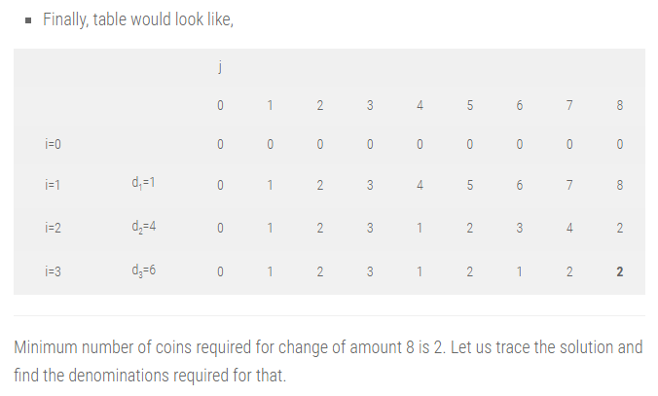
Making a Change Problem
Finally, table would look like,
Minimum number of coins required for change of amount 8 is 2.
Let us trace the solution and find the denominations required for that.

Slide 27
Making a Change Problem
TRACING SOLUTION:
For last cell in table, i and j would be 3 and 8 respectively.
C[n, N] = C[i, j] = C[3, 8] = 2
Step 1 : (i = 3, j = 8) : C[3, 8] = 2 and C[2, 8] = 2
Here, C[i, j] = C[i – 1, j], implies nothing was added in previous solution.
Algorithm has propagated the solution of previous iteration in current iteration.
So go to previous step by reducing i. So, i = i – 1 = 3 – 1 = 2

Slide 28
Making a Change Problem
Step 2 : (i = 2, j = 8) : C[2, 8] = 2 and C[1, 8] = 8
Here, C[i, j] ≠ C[i – 1, j], implies denomination d_{i} = d₂ = 4 was added in previous solution.
So add d_{i} in solution set and reduce problem size j by d_{i}.
Solution set S = {4}, j = j – d_{i} = 8 – 4 = 4.
Now we have, i = 2 and j = 4.

Slide 29
Making a Change Problem
Step 3 : (i = 2, j = 4) : C[2, 4] = 1 and C[1, 4] = 4
Here, C[i, j] ≠ C[i – 1, j], implies denomination d_{i} = d₂ = 4 was added in previous solution.
So add d_{i} in solution set and reduce problem size j by d_{i}.
Solution set S = {4, 4}, j = j – d_{i} = 4 – 4 = 0.
Problem size j is zero. So stop.
We need two coins of amount 4 for optimal change of amount 8.

Slide 30
Knapsack Problem
A dynamic programming is a technique for solving problems with overlapping subproblems. These subproblems are typically based on recurrence relation.
The method of solving knapsack problem also using dynamic programming approach.
The knapsack problem can be defined as follows :
If there are n items with the weights w₁, w₂,… w_{n} and values (profit associated with each item) v₁,v₂,...v_{n} and capacity of knapsack to be W, then find the most valuable subset of the items that fit into the knapsack.

Slide 31
Knapsack problem
0/1 Knapsack Problem:
The 0/1 knapsack problem means that the items are either completely or no items are filled in a knapsack.
For example, we have two items having weights 2kg and 3kg, respectively. If we pick the 2kg item then we cannot pick 1kg item from the 2kg item (item is not divisible); we have to pick the 2kg item completely.
This is a 0/1 knapsack problem in which either we pick the item completely or we will pick that item, it does not allow breaking of items. The 0/1 knapsack problem is solved by the dynamic programming.

Slide 32
Knapsack problem
Fractional knapsack problem:
The fractional knapsack problem means that we can divide or breaking the item.
For example, we have an item of 3 kg then we can pick the item of 2 kg and leave the item of 1 kg.
The fractional knapsack problem is solved by the Greedy approach.

Slide 33
Knapsack problem
Mathematical formulation for this algorithm
We can select any item only ones.
We can put items x_{i} in knapsack if knapsack can accommodate it.
If the item is added to a knapsack, the associated profit is accumulated.
If the weight of the item is larger than the remaining knapsack capacity, we skip the item, and the solution of the previous step remains as it is.
Otherwise, we should add the item to the solution set and the problem size will be reduced by the weight of that item.
Corresponding profit will be added for the selected item.

Slide 34
Knapsack problem Algorithm
Algorithm DP_KNAPSACK (V, W, M)
// Description: Solve binary knapsack problem using dynamic programming
// Input: Set of items X, set of weight W, profit of items V and knapsack capacity M
// Output: Array V, which holds the solution of problem
for i ← 1 to n do
V[i, 0] ← 0
end
for i ← 1 to M do
V[0, i] ← 0
end
for V[0, i] ← 0 do
for j ← 0 to M do
if w[i] ≤ j then
V[i, j] ← max{V[i-1, j], v[i] + V[i – 1, j – w[i]]}
else
V[i, j] ← V[i – 1, j] // if w[i]>j
end
end
end

Slide 35
Knapsack problem
For Example,
Weights ={3,4,6,5}
Profits(Values)={2,3,1,4}
Probability of x={0,0,0,0} if no item selected
{0,0,0,1} if 4th item selected , we will write 1
.
.
.
{0,1,1,1}
{1,1,1,1} if all selected.
W=8
n=4

Slide 36
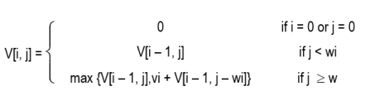
Knapsack problem
Dynamic programming divides the problem into small sub-problems.
Let V is an array of the solution of sub-problems.
V[i, j] represents the solution for problem size j with first i items.
The mathematical notion of the knapsack problem is given as :
      Where,
      V [1 …. n, 0 … M] : Size of the table
      V (n, M) = Solution
      n = Number of items

Slide 37
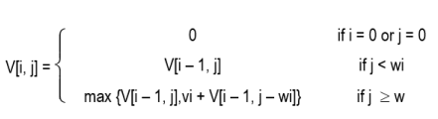
Knapsack problem
Example: Find an optimal solution for following 0/1 Knapsack problem using dynamic programming: Number of objects n = 4, Knapsack Capacity M = 5, Weights (W1, W2, W3, W4) = (2, 3, 4, 5) and profits (P1, P2, P3, P4) = (3, 4, 5, 6).
Solution: Solution of the knapsack problem is defined as,

Slide 38
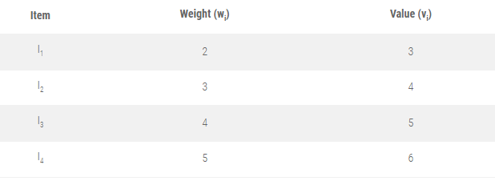
Knapsack problem

Slide 39
Knapsack problem
Boundary conditions would be V[0,i]=V[i, 0]=0 Initial configuration of table looks like.
j→
Item Detail |  |  | 0 | 1 | 2 | 3 | 4 | 5
i=0 |  |  | 0 | 0 | 0 | 0 | 0 | 0
i=1 | W1=2 | V1=3 | 0
i=2 | W2=3 | V2=4 | 0
i=3 | W3=4 | V3=5 | 0
i=4 | W4=5 | V4=6 | 0

Slide 40
Knapsack problem
Filling first column, j = 1
V [1, 1] ⇒ i = 1, j = 1, w_{i} = w₁ = 2
As, j < w_{i},
V [i, j] = V [i – 1, j]
V [1, 1] = V [0, 1]
= 0
V [2, 1] ⇒ i = 2, j = 1, w_{i} = w₂ = 3
As, j < w_{i},
V [i, j] = V [i – 1, j]
V [2, 1] = V [1, 1]
= 0
V [3, 1] ⇒ i = 3, j = 1, w_{i} = w₃ = 4
As, j < w_{i},
V [i, j] = V [i – 1, j]
V [3, 1] = V [2, 1] = 0
V [4, 1] ⇒ i = 4, j = 1, w_{i} = w₄ = 5
As, j < w_{i},
V[i, j] = V[i – 1, j]
V [4, 1] = V [3, 1] = 0

Slide 41
Knapsack problem
Filling first column, j = 2
V[1, 2] ⇒ i = 1, j = 2, w_{i} = w₁ = 2, v_{i} = 3
As, j ≥ w_{i},
V [i, j] =max {V [i – 1, j], v_{i} + V[i – 1, j – w_{i}] }
= max {V [0, 2], 3 + V [0, 0]}
V[1, 2] = max (0, 3)
= 3
V[2, 2] ⇒ i = 2, j = 2, w_{i} = w₂ = 3, v_{i} = 4
As, j < w_{i},
V [i, j] = V[i – 1, j]
V[2, 2] = V[1, 2]
= 3
V[3, 2] ⇒ i = 3, j = 2, w_{i} = w₃ = 4, v_{i} = 5
As, j < w_{i},
V[i, j] = V[i – 1, j]
V[3, 2] = V [2, 2] = 3
V[4, 2] ⇒ i = 4, j = 2, w_{i} = w₄ = 5, v_{i} = 6
As, j < w_{i}, V[i, j] = V[i – 1, j]
V[4, 2] = V[3, 2] = 3

Slide 42
Knapsack problem
Filling first column, j = 3
V[1, 3] ⇒ i = 1, j = 3, w_{i} = w₁ = 2, v_{i} = 3
As, j ≥ w_{i},
V [i, j] =max {V [i – 1, j], v_{i} + V [i – 1, j – w_{i}] }
= max {V [0, 3], 3 + V [0, 1]}
V[1, 3] = max (0, 3) = 3
V[2, 3] ⇒ i = 2, j = 3, w_{i} = w₂ = 3, v_{i} = 4
As, j ≥ w_{i},
V [i, j] = max {V [i – 1, j], v_{i} + V [i – 1, j – w_{i}] }
= max {V [1, 3], 4 + V [1, 0]}
V[2, 3] = max (3, 4) = 4
V[3, 3] ⇒ i = 3, j = 3, w_{i} = w₃ = 4, v_{i} = 5
As, j < w_{i},
V [i, j] = V [i – 1, j]
V[3, 3] = V [2, 3] = 4
V[4, 3] ⇒ i = 4, j = 3, w_{i} = w₄ = 5, v_{i} = 6
As, j < w_{i},
V[i, j] = V[i – 1, j]
V[4, 3] = V [3, 3] = 4

Slide 43
Knapsack problem
Filling first column, j = 4
V[1, 4] ⇒ i = 1, j = 4, w_{i} = w₁ = 2, v_{i} = 3
As, j ≥ w_{i},
V [i, j] = max {V [i – 1, j], v_{i} + V [i – 1, j – w_{i}] }
= max {V [0, 4], 3 + V [0, 2]}
V[1, 4] = max (0, 3) = 3
V[2, 4] ⇒ i = 2, j = 4, w_{i} = w₂ = 3 , v_{i} = 4
As, j ≥ w_{i},
V [i, j] = max {V [i – 1, j], v_{i} + V [i – 1, j – w_{i}] }
= max {V [1, 4], 4 + V [1, 1]}
V[2, 4] = max (3, 4 + 0) = 4
V[3, 4] ⇒ i = 3, j = 4, w_{i} = w₃ = 4, v_{i} = 5
As, j ≥ w_{i},
V [i, j] =max {V [i – 1, j], v_{i} + V [i – 1, j – w_{i}] }
=max {V [2, 4], 5 + V [2, 0]}
V[3, 4] =max (4, 5 + 0) = 5
V[4, 4] ⇒ i = 4, j = 4, w_{i} = w₄ = 5, v_{i} = 6
As, j < w_{i},
V [i, j] = V [i – 1, j]
V[4, 4] = V [3, 4] = 5

Slide 44
Knapsack problem
Filling first column, j = 5
V [1, 5] ⇒ i = 1, j = 5, w_{i} = w₁ = 2, v_{i} = 3
As, j ≥ w_{i},
V [i, j] = max {V [i – 1, j], v_{i} + V [i – 1, j – w_{i}] }
= max {V [0, 5], 3 + V [0, 3]}
V[1, 5] = max (0, 3) = 3
V[2, 5] ⇒ i = 2, j = 5, w_{i} = w₂ = 3, v_{i} = 4
As, j ≥ w_{i},
V [i, j] = max {V [i – 1, j], v_{i} + V [i – 1, j – w_{i}] }
= max {V [1, 5], 4 + V [1, 2]}
V[2, 5]= max (3, 4 + 3) = 7
V[3, 5] ⇒ i = 3, j = 5, w_{i} = w₃ = 4, v_{i} = 5
As, j ≥ w_{i},
V [i, j] = max {V [i – 1, j], v_{i} + V [i – 1, j – w_{i}] }
= max {V [2, 5], 5 + V [2, 1]}
V[3, 5] = max (7, 5 + 0) = 7
V [4, 5] ⇒ i = 4, j = 5, w_{i} = w₄ =5, v_{i} = 6
As, j ≥ w_{i},
V [i, j] = max {V [i – 1, j], v_{i} + V [i – 1, j – w_{i}] }
= max {V [3, 5], 6 + V [3, 0]}
V[4, 5] = max (7, 6 + 0) = 7

Slide 45
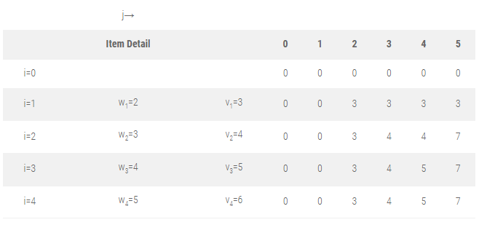
Knapsack problem

Slide 46
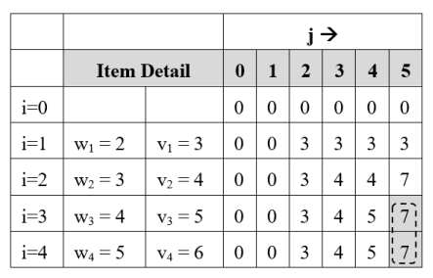
Knapsack problem
Find selected items for M = 5
Step 1 : Initially, i = n = 4, j = M = 5
V[i, j] = V[4, 5] = 7
V[i – 1, j] = V[3, 5] = 7
V[i, j] = V[i – 1, j],
so don’t select i^{th} item and check for the previous item.
so i = i – 1 = 4 – 1 = 3
Solution Set S = { }

Slide 47
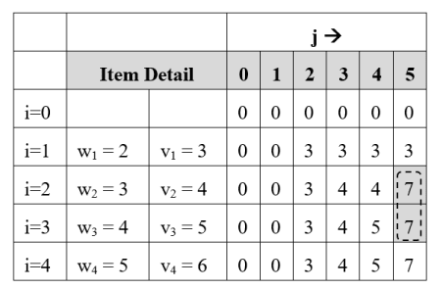
Knapsack problem
Step 2 : i = 3, j = 5
V[i, j] = V[3, 5] = 7
V[i – 1, j] = V[2, 5] = 7
V[i, j] = V[i – 1, j],
so don’t select i^{th} item and check for the previous item.
so i = i – 1 = 3 – 1 = 2
Solution Set S = { }

Slide 48
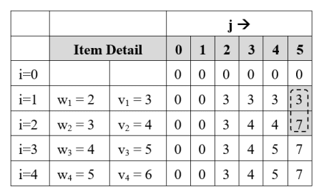
Knapsack problem
Step 3 : i = 2, j = 5
V[i, j] = V[2, 5] = 7
V[i – 1, j] = V[1, 5] = 3
V[i, j] ≠ V[i – 1, j],
so add item Ii = I₂ in solution set.
Reduce problem size j by w_{i}
j = j – w_{i} = j – w₂ = 5 – 3 = 2
i = i – 1 = 2 – 1 = 1
Solution Set S = {I₂}

Slide 49
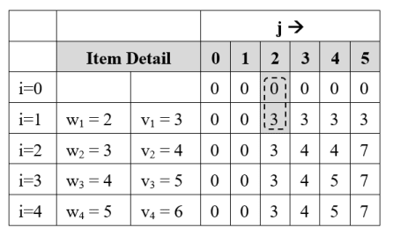
Knapsack problem
V[1, j] = V[1, 2] = 3
V[i – 1, j] = V[0, 2] = 0
V[i, j] ≠ V[i – 1, j],
so add item Ii = I₁ in solution set.
Reduce problem size j by w_{i}
j = j – w_{i} = j – w₁ = 2 – 2 = 0
Solution Set S = {I₁, I₂}
Problem size has reached to 0,
so final solution is
S = {I₁, I₂} Earned profit = P₁ + P₂ = 7
Step 4 : i = 1, j = 2

Slide 50
Assembly Line Scheduling
What is Assembly Line Scheduling?
Manufacturing of large items like car, trucks etc. generally undergoes through multiple station, where each station is responsible for assembling particular part only.
Entire product will be ready after it goes through predefined n stations in sequence.

Slide 51
Assembly line scheduling
Determine which station should be selected from assembly line 1 and which to choose from assembly line 2 in order to minimize the total time to build the entire product.
Selecting stations by randomly is quite infeasible. If there are n stations, unfortunately there are 2^{n} possible ways to choose stations.
Random selection takes O(2^{n}) time, it is not acceptable when n is large.

Slide 52
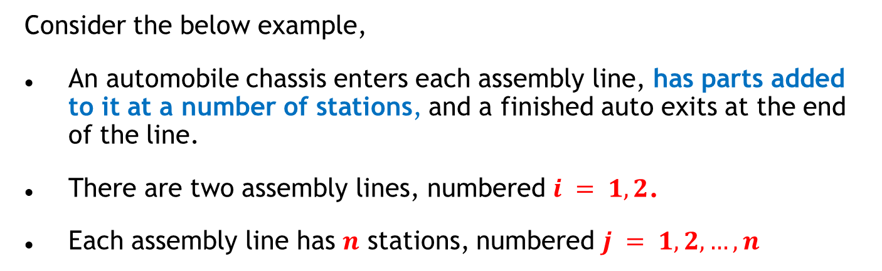
Assembly line scheduling
Consider the below example,
An automobile chassis enters each assembly line, has parts added to it at a number of stations, and a finished auto exits at the end of the line.
There are two assembly lines, numbered $i = 1, 2$.
Each assembly line has $n$ stations, numbered $j = 1, 2,…,n$

Slide 53
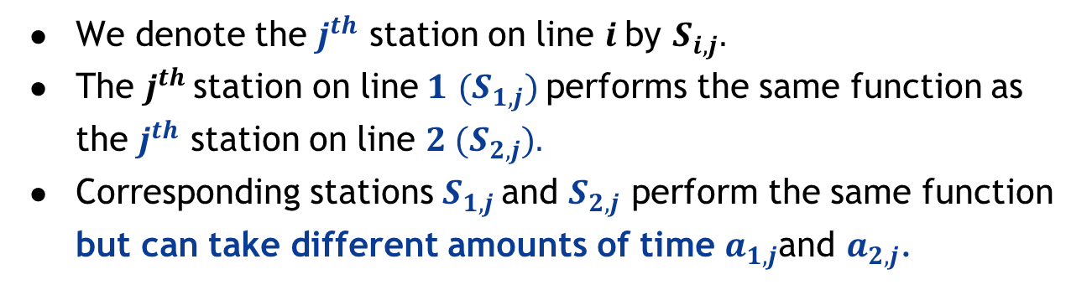
Assembly line scheduling
We denote the $j^{th}$ station on line $i$by $S_{i,j}.$
The $j^{th}$ station on line$1$ $(S_{1,j})$performs the same function as the $j^{th}$ station on line $2 (S_{2,j}).$
Corresponding stations $S_{1,j}$ and $S_{2,j}$ perform the same function but can take different amounts of time $a_{1,j}$and $a_{2,j}$.

Slide 54
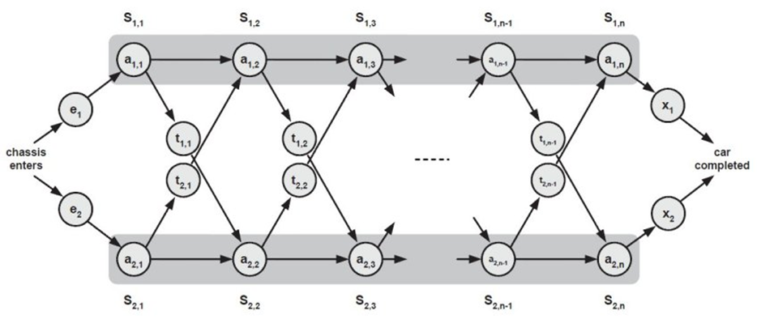
Assembly line scheduling

Slide 55
Assembly line scheduling
Algorithm ASSEMBLY_LINE_SCHEDULING(n, e, a, t,x)
// n is number of stations on both assembly
// e is array of entry time on assembly
// a is array of assembly time on given station
// t is array of the time required to change assembly line
//x is array of exit time from assembly
f1[1] ← e1 + a1,1
f2[1] ← e2 + a2,1
for j ← 2 to n do
if f1[j - 1] + a1, j ≤ f2[j – 1] + t[j – 1] + t + a2, j then
f1[j] ← f1[j – 1] + a1, j
L1[j] ← 1
else
f1[j] ← f2[j – 1] + t2,j – 1+ a1, j
L1[j] ← 2
end
if f2[j – 1] + a2, j ≤ f1[j – 1] + t1, j – 1 + a2, j then
f2[j] ← f2[j – 1] + a2, j
L2[j] ← 2
else
f2[j] ← f1[j – 1] + t1, j – 1 + a2, j
L2[j] ← 1
end
if f1[n] + x1 ≤ f2[n] + x2 then
F* ← f1[n] + x1
L* ← 1
else
F* ← f2[n] + x2
L* ← 2
end
end

Slide 56
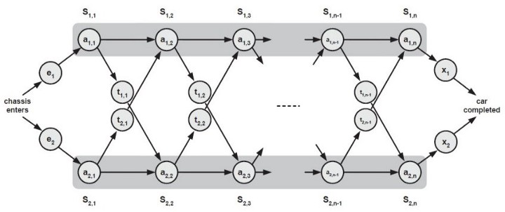

Assembly line scheduling
Entry times are: $e_{1}$and $e_{2}$; exit times are: $x_{1}$and $x_{2}$
After going through a station, a chassis can either:
  stay on same line at no cost, or
  transfer to other line: cost after $S_{i,j}$ is $T_{i,j}$ for $j=1, . . . , n –1$

Slide 57
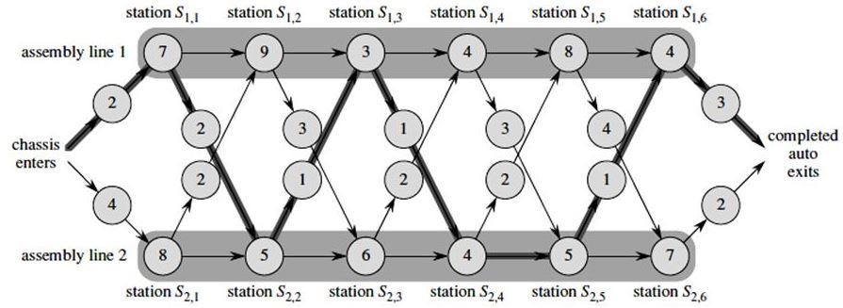
Assembly line scheduling – Example
Using dynamic programming technique, find the fastest time to get through the entire factory for the following:

Slide 58
Assembly line scheduling
Terminologies :
  S_{ij} = Station j on assembly line i.
  a_{ij} = Time needed to assemble the partial component at station j on assembly line i.
  t_{ij} = Time required to transfer component from one assembly to other from station j to (j + 1).
  e_{i} = Entry time on assembly line i.
  x_{i} = Exit time from assembly line i.

Slide 59
Assembly line scheduling
Mathematical formulation
Time required to build component on first station of both line is summation of entry time for particular assembly line and assembly time on first station of particular line.
f_{i} [j] = e_{i} + a_{i1} ; Initial condition (if j == 1), i = 1, 2

Slide 60
Assembly line scheduling
Minimum time required to put the partially assembled product out of any station j on line 1 is minimum of :
(Minimum time taken up to station j – 1 on same assembly line 1) + (assembly time on station j of same assembly line)
(Minimum time taken up to station j – 1 on assembly line 2) + (assembly line transfer time) + (assembly time on station j of assembly line 2)

Slide 61
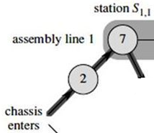
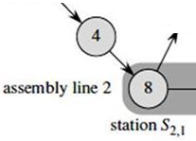
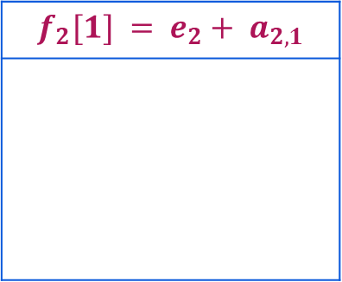
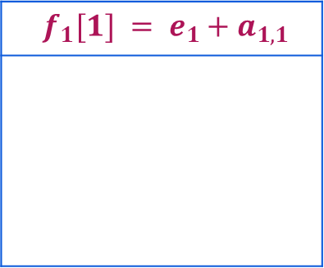

Assembly line scheduling
Step 1:
$f^{∗}$: the fastest time to get through the entire factory
$f_{i}\left[j\right]$: the fastest time to get from the starting point through station $S_{i,j}$.
Base case: $j=1, i=1, 2$(getting through station $1$)
$f_{1}[1] = e_{1}+a_{1,1}$
$$f_{2}[1] = e_{2}+ a_{2,1}$$

Slide 62

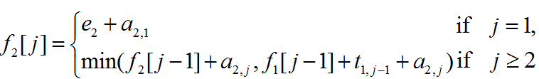
Assembly line scheduling
General Case: 𝑗 = 2, 3, …,𝑛 and 𝑖 = 1, 2 - Recursive solution

Slide 63
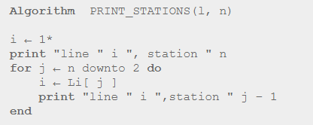
Assembly line scheduling
The above algorithm will just tell us the minimum time required to take away the product from station n.
It does not tell anything about the sequence of stations on assembly.
We can find the station sequence by tracing the solution using the following algorithm.

Slide 64
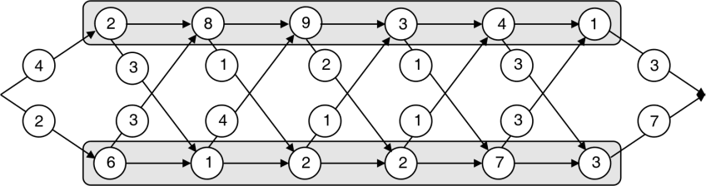
Assembly line scheduling
Find optimal assembly line schedule for given data.

Slide 65
Assembly line scheduling -Example 1
Solution:
f_{i} [j] = e_{i} + a_{i},₁; Initial condition (j = 1, i=1, 2)
f₁ [j] = min (f₁ [j – 1] + a_{1j}, f₂ [j – 1] + t_{2 j – 1}) + a_{1j})
f₂ [j] = min (f₁ [j – 1] + t₁ _{j – 1}) + a_{2j}, f₂ [j – 1] + a_{2j} )
f* = min (f₁ [n] + x₁, f₂ [n]+x₂ )
f₁ [1] = e₁ + a₁₁
= 4 + 2
= 6
f₂ [1] = e₂ + a₂₁
= 2 + 6
= 8

Slide 66
Assembly line scheduling -Example 1
f₁ [2] = min (f₁[j – 1] + a_{1j}, f₂ [j – 1] + t_{2j – 1}+ a_{1j} )
= min (f₁ [1] + a₁₂, f₂ [1] + t₂₁ + a₁₂)
= min (6 + 8, 8 + 3 + 8)
= min (14, 19)
= 14
f2 [2] = min (f1 [j – 1] + tj – 1 + a2j, f2 [j – 1] + a2j)
= min (f1[1] + t11 + a22, f2 [1] + a22 )
= min (6 + 3 + 11, 8 + 11)
= min(20, 19)
= 19

Slide 67
Assembly line scheduling -Example 1
f1 [3] = min (f1[j – 1] + a1j, f2 [j – 1] + t2j – 1) + a1j )
= min (f1[2] + a13, f2 [2] + t22 + a13 )
= min (14 + 9, 19 + 4 + 9)
= min (23, 32)
= 23
f2 [3] = min (f1[j – 1] + tj – 1 + a2j, f2 [j – 1] + a2j )
= min (f1[2] + t12 + a23, f2 [2] + a23)
= min (14 + 1 + 2, 19 + 2)
= min (17, 21)
= 17

Slide 68
Assembly line scheduling -Example 1
f₁ [4] = min (f₁ [j – 1] + a_{1j}, f₂ [j – 1] + t_{2j – 1} + a_{1j} )
= min (f₁ [3] + a₁₄, f₂ [3] + t₂₃ + a₁₄)
= min (23 + 3 , 17 + 1 + 3)
= min (26, 21)
= 21
f₂ [4] = min (f₁ [j – 1] + t_{j – 1} + a_{2j}, f₂ [j – 1] + a_{2j})
= min(f₁ [3] + t₁₃ + a₂₄, f₂ [3] + a₂₄)
= min (23 + 2 + 2, 17 + 2)
= min(27, 19)
= 19

Slide 69
Assembly line scheduling -Example 1
Hence we can summarize f₁[j] and f₂[j] as follows :
 | j = 1 | j = 2 | j= 3 | j = 4 | j = 5 | j = 6
f₁[j] | 6 | 14 | 23 | 21 | 24 | 25
f₂[j] | 8 | 17 | 19 | 26 | 29 | 29
f* = min (f₁ [n] + x₁, f₂ [n] + x₂)
f* = min (25 + 3, 29 + 7)
= min (28, 36)
= 28

Slide 70
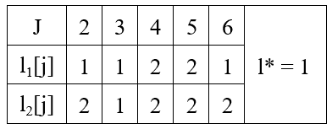
Assembly line scheduling -Example 1
Compute fastest path :

Slide 71
Assembly line scheduling -Example 1
Trace back the path :
* = 1, so we have to select last station S_{1,6} on line 1. Now we will look at l₁[6], which is 1, so we will select previous station on line 1 that is station S_{1, 5}.
Now we will look at l_{1, 5} which is 2 so we will change line to 2 and previous station that is S_{2, 4}.
Next observe l₂[4], its 2 so we have to remain on same line and select station S_{2, 3}. Now observe l₂[3], which is 1, so move on station S_{1,2} on line 1. Now observe l₁[3], which is 1, so remain on same line.

Slide 72
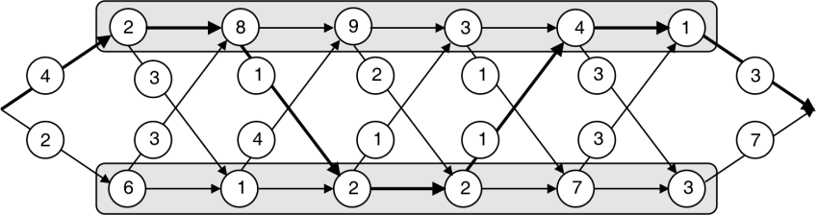
Assembly line scheduling -Example 1
At last you can draw the Final path(Result) like this, shown in following figure

Slide 73
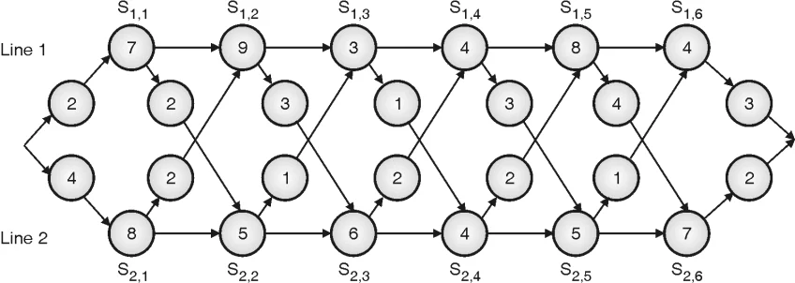
Assembly line scheduling
Solve the following

Slide 74
Matrix Chain Multiplication
Matrix Chain Multiplication is solved using dynamic programming.
It is a optimization problem that aims to determine the most efficient way to multiply a given sequence of matrices.
The problem is not about multiplying the matrices themselves but about figuring out the optimal order to minimize the number of scalar multiplications.

Slide 75
Matrix Chain Multiplication
Problem:
In what order, n matrices A₁, A₂, A₃, …. A_{n} should be multiplied so that it would take a minimum number of computations to derive the result.
The matrices need to be compatible for multiplication, i.e., if matrix A_{i} has dimensions p_{i-1} X p_{i} then matrix A_{i+1} ​must have dimensions p_{i} X p_{i+1.}

Slide 76

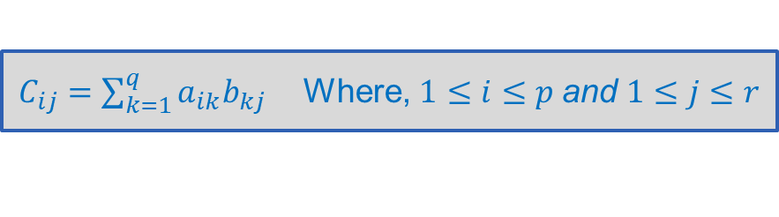

Matrix Chain Multiplication
Let matrix $A (p× q)$and matrix $B (q × r)$are two given matrices for multiplication.
The resultant matrix $C=A ∙B$
So,
$C_{ij}=\sum_{k=1}^{q}{a_{ik}b_{kj}}$ Where, $1≤i≤p$and $1≤j≤r$
$A=\left[\begin{matrix}A_{11} & A_{12} & A_{13} \\ A_{21} & A_{22} & A_{23}\end{matrix}\right]$ and $B=\left[\begin{matrix}B_{11} & B_{12} \\ B_{21} & B_{22} \\ B_{31} & B_{32}\end{matrix}\right]$
$$C_{11}=A_{11}∙B_{11}+A_{12}∙B_{21}+A_{13}∙B_{31}$$
$$C_{12}=A_{11}∙B_{12}+A_{12}∙B_{22}+A_{13}∙B_{32}$$
$$C_{21}=A_{21}∙B_{11}+A_{22}∙B_{21}+A_{23}∙B_{31}$$
$$C_{22}=A_{21}∙B_{12}+A_{22}∙B_{22}+A_{23}∙B_{32}$$

Slide 77
Matrix Chain Multiplication
Consider a chain of matrices to be multiplied together. For example, we have matrices A, B, C, and D.
The goal is to find the most efficient order of multiplication that minimizes the total number of scalar multiplications required.
In this case, we can multiply them in different orders: ((AB)C)D, (A(BC))D, or A((BC)D).
The Matrix Chain Algorithm helps us determine the optimal order.

Slide 78
Matrix Chain Multiplication
Suppose dimension of three matrices are :
A₁ = 5 x 4 A₂ = 4 x 6 A₃ = 6 x 2
Matrix multiplication is associative. So
(A₁ A₂ ) A₃ = {(5 x 4 ) x (4 x 6) } x (6 x 2)
= (5 x 4 x 6) + (5 x 6 x 2)
= 180
A₁ (A₂ A₃) = (5 x 4) x {(4 x 6) x (6 x 2) }
= (5 x 4 x 2) + (4 x 6 x 2)
= 88
The answer of both multiplication sequences would be the same, but the numbers of multiplications are different.
This leads to the question, what order should be selected for a chain of matrices to minimize the number of multiplications.

Slide 79
Algorithm to Solve Matrix Chain Multiplication
Let’s break down the steps of the algorithm:
1. Define the problem:
Given a chain of matrices A1, A2, A3, …, An, where the dimensions of matrix Ai are d[i-1] x d[i] for i = 1 to n.
The goal is to find the optimal order of matrix multiplication to minimize the total number of scalar multiplications.
2. Create a table:
Create an n x n table, where n is the number of matrices in the chain.

Slide 80
Algorithm to Solve Matrix Chain Multiplication
The table, let’s call it M, will store the minimum number of scalar multiplications required to multiply the subchains of matrices.
3. Initialize the table:
Set the diagonal entries of M to 0, as the subchains of length 1 do not require any multiplication.
4. Fill in the table:
Iterate over the table diagonally, starting from the subchains of length 2 and gradually increasing the length.
For each subchain length k, starting from matrix i, calculate the minimum number of scalar multiplications.

Slide 81
Algorithm to Solve Matrix Chain Multiplication
For each possible split point j, where i ≤ j < i + k, calculate the number of scalar multiplications as follows:
  Compute the number of scalar multiplications required for the left subchain: M[i][j]
  Compute the number of scalar multiplications required for the right subchain: M[j+1][i+k]
  Calculate the number of scalar multiplications for the current split point: d[i-1] * d[j] * d[i+k] + M[i][j] + M[j+1][i+k]
  Update the table entry M[i][i+k] with the minimum value among all possible split points.

Slide 82
Algorithm to Solve Matrix Chain Multiplication
5.Backtrack the optimal solution:
To determine the optimal order of matrix multiplication, track the split that gives the minimum number of scalar multiplications for each subchain.
This can be achieved by storing additional information during the table-filling step, such as the split points that yield the minimum number of scalar multiplications for each subchain.

Slide 83
Algorithm to Solve Matrix Chain Multiplication
6. Return the result:
The minimum number of scalar multiplications required to multiply the entire chain is stored in M[1][n], where n is the number of matrices in the chain.
The optimal order of matrix multiplication can be obtained by backtracking through the split points stored during the algorithm execution.

Slide 84
Matrix Chain Multiplication
Algorithm MATRIX_CHAIN_ORDER(p)
// p is sequence of n matrices
n ← length(p) – 1 // Number of matrices
for i ← 1 to n do
m[i,i] ← 0
end
for l ← 2 to n do
for i ← 1 to n – l + 1 do
j ← i + l - 1
m[i, j] ← ∞
for k ← i to j – 1 do
q ← m[i, k]+ m[k + 1, j] + di – 1 * dk * dj
if q < m[i, j] then
m[i,j ] ← q
s[i, j] ← k // Store the split position
end
end
end
end
return m and s

Slide 85
Matrix Chain Multiplication - Example
Let’s consider an example to illustrate the matrix chain multiplication.
Suppose we have a chain of four matrices: A, B, C, and D, with dimensions as follows:
    A: 10 x 30
    B: 30 x 5
    C: 5 x 60
    D: 60 x 8

Slide 86
Matrix Chain Multiplication - Example
The goal is to find the optimal order of multiplying these matrices that minimizes the total number of scalar multiplications.
To solve this problem, we can apply the Matrix Chain Multiplication algorithm using dynamic programming. Let’s go step by step,

Slide 87
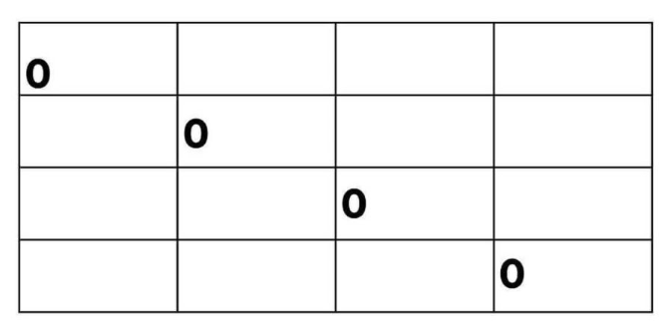
Matrix Chain Multiplication - Example
Step 1:
Create the table We create a 4×4 table to store the minimum number of scalar multiplications needed for each subchain. The table initially looks like this:

Slide 88
Matrix Chain Multiplication - Example
Step 2:
Fill in the table We iterate diagonally through the table, calculating the minimum number of scalar multiplications for each subchain.
First, we consider subchains of length 2:
For the subchain AB, the only option is multiplying matrices A and B, resulting in 10 x 5 scalar multiplications.
For the subchain BC, the only option is multiplying matrices B and C, resulting in 30 x 5 scalar multiplications.

Slide 89
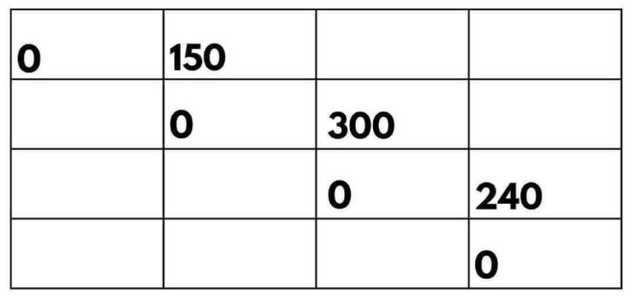
Matrix Chain Multiplication - Example
For the subchain CD, the only option is multiplying matrices C and D, resulting in 5 x 8 scalar multiplications.
Updating the table:

Slide 90
Matrix Chain Multiplication - Example
Next, we consider subchains of length 3:
For the subchain ABC, we have two options: (AB)C or A(BC). Let’s calculate the scalar multiplications for each option:
(AB)C: We multiply matrices A and B (10 x 30) resulting in a temporary matrix of size 10 x 5.
Then, we multiply this temporary matrix with matrix C (10 x 5) resulting in a final matrix of size 10 x 60.
The total scalar multiplications for this option are 10 x 30 x 5 + 10 x 5 x 60 = 4500.

Slide 91
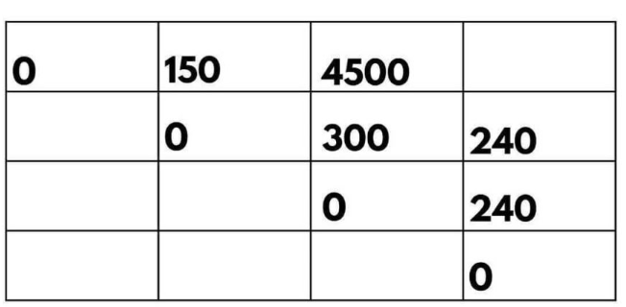
Matrix Chain Multiplication - Example
A(BC): We multiply matrices B and C (30 x 5) resulting in a temporary matrix of size 30 x 60.
Then, we multiply matrix A (10 x 30) with this temporary matrix, resulting in a final matrix of size 10 x 60.
The total scalar multiplications for this option are 10 x 30 x 60 + 10 x 5 x 60 = 9000.
Updating the table:

Slide 92
Matrix Chain Multiplication - Example
A(BC): We multiply matrices B and C (30 x 5) resulting in a temporary matrix of size 30 x 60.
Then, we multiply matrix A (10 x 30) with this temporary matrix, resulting in a final matrix of size 10 x 60.
The total scalar multiplications for this option are 10 x 30 x 60 + 10 x 5 x 60 = 9000.
Updating the table:

Slide 93
Matrix Chain Multiplication
Finally, we consider the entire chain of matrices ABCD:
We have two options: ((AB)C)D or (A(BC))D. Calculating the scalar multiplications for each option:
((AB)C)D: We multiply matrices (AB) and C, resulting in a temporary matrix of size 10 x 60.
Then, we multiply this temporary matrix with matrix D (10 x 60), resulting in a final matrix of size 10 x 8.
The total scalar multiplications for this option are
10 x 5 x 60 + 10 x 60 x 8 = 6000.

Slide 94
Matrix Chain Multiplication
(A(BC))D: We multiply matrices A and (BC), resulting in a temporary matrix of size 10 x 60.
Then, we multiply this temporary matrix with matrix D (10 x 60), resulting in a final matrix of size 10 x 8.
The total scalar multiplications for this option is 10 x 30 x 5 + 10 x 5 x 8 = 1300.

Slide 95
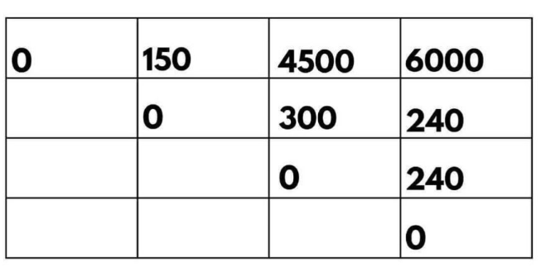
Matrix Chain Multiplication
Updating the table:

Slide 96
Matrix Chain Multiplication
Step 3:
Backtrack the optimal solution To determine the optimal order of multiplication, we start at M[1, 4], which gives us the minimum number of scalar multiplications for the entire chain.
In this case, M[1, 4] = 6000, indicating that ((AB)C)D is the optimal order.
Step 4:
Return the result The minimum number of scalar multiplications required to multiply the entire chain is 6000, and the optimal order is ((AB)C)D.

Slide 97
Longest Common Subsequence(LCS)
The Longest Common Subsequence (LCS) is a classic problem that deals with finding the longest subsequence common to two sequences.
A subsequence is a sequence that appears in the same relative order but not necessarily consecutively.
LCS is widely used in fields such as bioinformatics for sequence alignment, in different tools to show differences between files, and in version control systems.

Slide 98
Longest Common Subsequence(LCS)
A subsequence of a string is a new string generated from the original string with some characters (can be none) deleted without changing the relative order of the remaining characters.
For Example, In Given two strings text1 and text2, return the length of their longest common subsequence. If there is no common subsequence, return 0.
A subsequence is a sequence that appears in the same relative order, but not necessarily contiguous.

Slide 99
Longest Common Subsequence(LCS)
We use dynamic programming technique to find the longest common subsequence (LCS).
Let A = < a1, a2, a3 …an> and B = < b1, b2, b3 …bm> be two strings over an alphabets. Then B is subsequence of A, if B can be generated by striking out some elements from A.
By subsequence, we mean that the values must occur in the order of the sequence, but they need not be consecutive.

Slide 100
Longest Common Subsequence(LCS)
The common subsequence of A and B is the subsequence that can be generated by striking some characters from A and B both.
If A = {a, b, a, c, b, c, b} and B = {a, b, c, b, b, a, c}, then the sequence {a, c}, {a, b, c}, {a, c, c}, {a, b, c, b} etc. are common subsequence's of A and B, but {a, b, c, b, a} is not. {a, b, c, b, a} is a subsequence of B but it is not a subsequence of A.
String of length m has 2m subsequence's. So finding the longest common subsequence's using the brute force approach takes exponential time. Such algorithms are practically not useful for long sequences.

Slide 101
Longest Common Subsequence(LCS)
Algorithm LONGEST_COMMON_SUBSEQUENCE(X, Y)
// X is string of length n
// Y is string of length m
for i ← 1 to m do
LCS [i, 0] ← 0
end
for j ← 0 to n
do
LCS [0, j] ← 0
end
for i ← 1 to m do
for j ← 1 to n do
if Xi = = Yj then
LCS[i, j] ← LCS[i – 1, j – 1] + 1
else
if LCS[i – 1, j] ≥ LCS[i, j – 1] then
LCS[i, j] ← LCS[i – 1, j]
else
LCS[i, j] ← LCS[i, j – 1]
end
end
end
end
return LCS

Slide 102
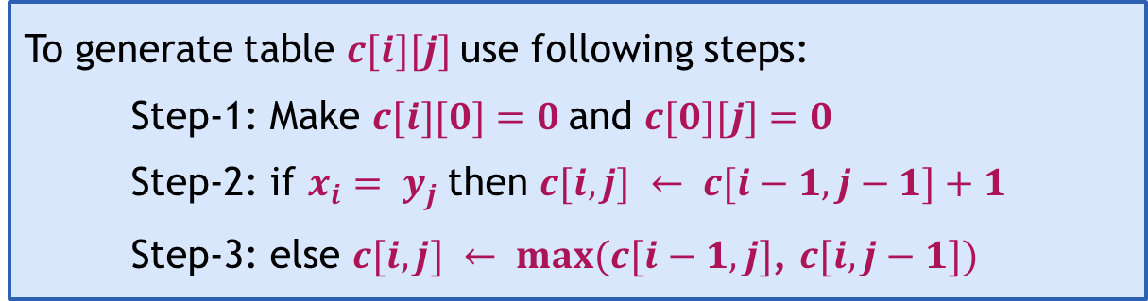

Longest Common Subsequence(LCS)
LCS – Optimal Sub-structure
We need to generate table $c\left(1..m, 1..n\right)$
where $m=$length of string $S1$ and $n=$ length of string $S2$.
To generate table $c[i][j]$use following steps:
  Step-1: Make $c[i][0]=0$and $c[0][j]=0$
  Step-2: if $x_{i}= y_{j}$then $c[i,j] ← c[i−1,j−1]+1$
  Step-3: else $c[i,j] ← max(c[i−1,j]$, $c[i,j−1])$

Slide 103
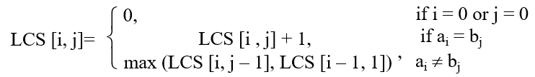
Longest Common Subsequence(LCS) -Example
Problem:
Given two sequences of characters, P=MLNOM, Q=MNOM. Obtain the longest common subsequence.
Solution:
Given two strings are P = MLNOM and Q = MNOM
The optimal substructure of LCS problem using dynamic programming is given as,

Slide 104
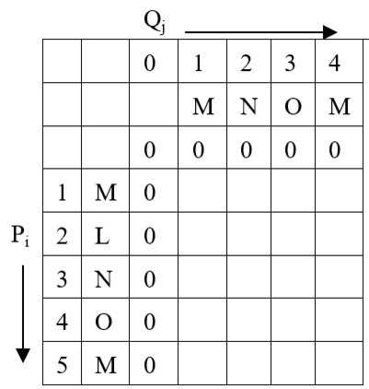
LCS- Example
Initially, the table looks like,

Slide 105
LCS- Example
Let’s compute the remaining cell values row by row :
Computation for row 1 :
LCS [1, 1] ⇒ i = 1, j = 1, Pi = M, Qj = M
Pi = Qj ⇒ LCS [i, j] = 1 + LCS[i – 1, j – 1]
LCS [1, 1] = 1 + LCS[0, 0] = 1 + 0 = 1
LCS [1, 2] ⇒ i = 1, j = 2, Pi = M, Qj = N
Pi ≠ Qj ⇒ LCS [i, j] = max (LCS [i – 1 , j], LCS [i, j – 1])
LCS [1, 2] = max (LCS [0, 2], LCS [1, 1]) = max (0, 1) = 1
LCS [1, 3] ⇒ i = 1, j = 3, P_{i} = M, Q_{j} = O
P_{i} ≠ Q_{j} ⇒ LCS [i, j] = max (LCS [i – 1 , j], LCS [i, j – 1])
LCS [1, 3] = max(LCS[0, 3], LCS[1, 2]) = max(0, 1) = 1
LCS [1, 4] ⇒ i = 1, j = 4, P_{i} = M, Q_{j} = M
P_{i} = Q_{j} ⇒ LCS [i, j] = 1 + LCS[i – 1, j – 1]
LCS [1, 4] = 1 + LCS[0, 3] = 1 + 0 = 1

Slide 106
LCS- Example
Computation for row 2 :
LCS [2, 1] ⇒ i = 2, j = 1, P_{i} = L, Q_{j} = M
P_{i} ≠ Q_{j} ⇒ LCS [i, j] = max (LCS [i – 1 , j], LCS [i, j – 1])
LCS [2, 1] = max (LCS [1, 1], LCS [2, 0]) = max (1, 0) = 1
LCS [2, 2] ⇒ i = 2, j = 2, P_{i} = L, Q_{j} = N
P_{i} ≠ Q_{j} ⇒ LCS [i, j] = max (LCS [i – 1 , j], LCS [i, j – 1])
LCS [2, 2] = max (LCS [1, 2], LCS [2, 1]) = max (1, 1) = 1
LCS [2, 3] ⇒ i = 2, j = 3, P_{i} = L, Q_{j} = O
P_{i} ≠ Q_{j} ⇒ LCS [i, j] = max (LCS [i – 1 , j], LCS [i, j – 1])
LCS [2, 3] = max(LCS[1, 3], LCS[2, 2]) = max(1, 1) = 1
LCS [2, 4] ⇒ i = 2, j = 4, P_{i} = L, Q_{j} = M
P_{i} ≠ Q_{j} ⇒ LCS [i, j] = max (LCS [i – 1 , j], LCS [i, j – 1])
LCS [2, 4] = max (LCS [1, 4], LCS [2, 3]) = max (1, 1) = 1

Slide 107
LCS- Example
Computation for row 3 :
LCS [3, 1] ⇒ i = 3, j = 1, P_{i} = N, Q_{j} = M
P_{i} ≠ Q_{j} ⇒ LCS [i, j] = max (LCS [i – 1 , j], LCS [i, j – 1])
LCS [3, 1] = max (LCS [2, 1], LCS [3, 0]) = max (1, 0) = 1
LCS [3, 2] ⇒ i = 3, j = 2, P_{i} = N, Q_{j} = N
P_{i} = Q_{j} ⇒ LCS [i, j] = 1 + LCS[i – 1, j – 1]
LCS [3, 2] = 1 + LCS[2, 1] = 1 + 1 = 2
LCS [3, 3] ⇒ i = 3, j = 3, P_{i} = N, Q_{j} = O
P_{i} ≠ Q_{j} ⇒ LCS [i, j] = max (LCS [i – 1 , j], LCS [i, j – 1])
LCS [3, 3] = max(LCS[2, 3], LCS[3, 2]) = max(1, 2) = 2
LCS [3, 4] ⇒ i = 3, j = 4, P_{i} = N, Q_{j} = M
P_{i} ≠ Q_{j} ⇒ LCS [i, j] = max (LCS [i – 1 , j], LCS [i, j – 1])
LCS [3, 4] = max (LCS [2, 4], LCS [3, 3]) = max (1, 2) = 2

Slide 108
LCS- Example
Computation for row 4 :
LCS [4, 1] ⇒ i = 4, j = 1, P_{i} = O, Q_{j} = M
P_{i} ≠ Q_{j} ⇒ LCS [i, j] = max (LCS [i – 1 , j], LCS [i, j – 1])
LCS [4, 1] = max (LCS [3, 1], LCS [4, 0]) = max (1, 0) = 1
LCS [4, 2] ⇒ i = 4, j = 2, P_{i} = O, Q_{j} = N
P_{i} ≠ Q_{j} ⇒ LCS [i, j] = max (LCS [i – 1 , j], LCS [i, j – 1])
LCS [4, 2] = max (LCS [3, 2], LCS [4, 1]) = max (2, 1) = 2
LCS [4, 3] ⇒ i = 4, j = 3, P_{i} = O, Q_{j} = O
P_{i} = Q_{j} ⇒ LCS [i, j] = 1 + LCS[i – 1, j – 1]
LCS [4, 3] = 1 + LCS[3, 2] = 1 + 2 = 3
LCS [4, 4] ⇒ i = 4, j = 4, P_{i} = O, Q_{j} = M
P_{i} ≠ Q_{j} ⇒ LCS [i, j] = max (LCS [i – 1 , j], LCS [i, j – 1])
LCS [4, 4] = max (LCS [3, 4], LCS [4, 3]) = max (2, 3) = 3

Slide 109
LCS- Example
Computation for row 5 :
LCS [5, 1] ⇒ i = 5, j = 1, P_{i} = M, Q_{j} = M
P_{i} = Q_{j} ⇒ LCS [i, j] = 1 + LCS[i – 1, j – 1]
LCS [5, 1] = 1 + LCS[4, 0] = 1 + 0 = 1
LCS [5, 2] ⇒ i = 5, j = 2, P_{i} = M, Q_{j} = N
P_{i} ≠ Q_{j} ⇒ LCS [i, j] = max (LCS [i – 1 , j], LCS [i, j – 1])
LCS [5, 2] = max (LCS [4, 2], LCS [5, 1]) = max (2, 1) = 2
LCS [5, 3] ⇒ i = 5, j = 3, P_{i} = M, Q_{j} = O
P_{i} ≠ Q_{j} ⇒ LCS [i, j] = max (LCS [i – 1 , j], LCS [i, j – 1])
LCS [5, 3] = max (LCS [4, 3], LCS [5, 2]) = max (3, 2) = 3
LCS [5, 4] ⇒ i = 5, j = 4, P_{i} = M, Q_{j} = M
P_{i} = Q_{j} ⇒ LCS [i, j] = 1 + LCS[i – 1, j – 1]
LCS [5, 4] = 1 + LCS[5, 3] = 1 + 3 = 4

Slide 110
LCS- Example
So finally, table would be,
Q_{j}
P_{i}
 | 0 | M | N | O | M
0 | 0 | 0 | 0 | 0 | 0
M | 0 | 1 | 1 | 1 | 1
L | 0 | 1 | 1 | 1 | 1
N | 0 | 1 | 2 | 2 | 2
O | 0 | 1 | 2 | 3 | 3
M | 0 | 1 | 2 | 3 | 4

Slide 111
LCS- Example
Trace the solution:
Longest common subsequence for given strings is of length 4. Let us find LCS of P and Q :
Step 1: i = 5, j = 4, Pi = M, Qj = M
Pi = Qi, so add Pi to solution set. And move diagonally back.
Solution set S = {M }
Step 2: i = 4, j = 3, Pi = O, Qj = O
Pi = Qi, so add Pi to solution set. And move diagonally back.
Solution set S = { M, O }

Slide 112
LCS- Example
Step 3: i = 3, j = 2, Pi = N, Qj = N
P_{i} = Q_{i}, so add Pi to solution set. And move diagonally back.
Solution set S = { M, O, N }
Step 4: i = 2, j = 1, P_{i} = L, Q_{j} = M
P_{i} ≠ Q_{j}, and LCS[i, j] is derived from LCS[i – 1, j]. So move in vertical direction.
Solution set S = { M, O, N }
Step 5: i = 1, j = 1, P_{i} = M, Q_{j} = M
P_{i} = Q_{i}, so add Pi to solution set. And move diagonally back.
Solution set S = { M, O, N, M }

Slide 113
Thank you!!

